Slide 1
AZ-900 Study Group – Week 3

Slide 2
Introductions
Presenter 1
Title
Presenter 2
Title
Presenter 3
Title
Presenter 4
Title
Presenter 6
Title

Slide 3
Customer Specific intro Topics
Insert Slides Covering:
Customer specific learning management system links.
Survey information
Guidance on study group format

Slide 4
Azure Fundamentals Certification and the AZ-900 Exam

Slide 5
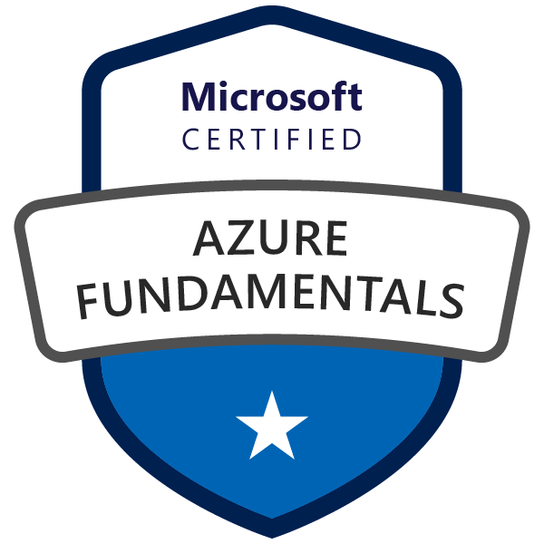
Microsoft Certified – Azure Fundamentals
Goal: Prove that you understand cloud concepts, core Azure Services, Azure pricing and support, the fundamentals of cloud security, privacy, compliance and trust.
Value: The knowledge gained by acquiring this certification will provide a valuable foundation for working with the platform and continuing on to more advanced role based Azure certifications.

Slide 6

Azure Role-based Certifications
Fundamentals
Associate
Expert
Azure Administrator Associate
Exam AZ-103
Azure DevOps Engineer Expert
Azure Developer Associate
Exams AZ-400
Exam AZ-203
Azure Security Engineer Associate
Azure Fundamentals
Exam AZ-500
Exam AZ-900
Azure Solutions Architect Expert
Azure AI Engineer Associate
Exams AZ-300 + AZ-301
Exam AI-100
Azure Data Engineer Associate
Exam DP-200
More roles to come ...
Azure Certification Exams: aka.ms/ExamsAzure

Slide 7
Exam Blueprint ( AZ-900 )
Study areas | Weights
Understanding cloud concepts | 15-20%
Understanding core Azure services | 30-35%
Understand security, privacy, compliance, and trust | 30-35%
Understand Azure pricing and support | 25-30%
Percentages indicate the relative weight of each area on the exam.
The higher the percentage, the more questions you are likely to see in that area.
Absolutely an accurate representation of what questions will show up.

Slide 8
Understand security, privacy, compliance, and trust (30-35%)
Understand securing network connectivity in Azure
describe Azure Firewall
describe Azure DDoS Protection
describe Network Security Group (NSG)
choose an appropriate Azure security solution
Describe core Azure Identity services
understand the difference between authentication and authorization
describe Azure Active Directory
describe Azure Multi-Factor Authentication
Describe security tools and features of Azure
describe Azure Security
understand Azure Security center usage scenarios
describe Key Vault
describe Azure Information Protection (AIP)
describe Azure Advanced Threat Protection (ATP)
Describe Azure governance methodologies
describe Azure Policies
describe Initiatives
describe Role-Based Access Control (RBAC)
describe Locks
describe Azure Advisor security assistance
Understand monitoring and reporting options in Azure
describe Azure Monitor
describe Azure Service Health
understand the use cases and benefits of Azure Monitor and Azure Service Health
Understand privacy, compliance and data protection standards in Azure
understand industry compliance terms such as GDPR, ISO and NIST
understand the Microsoft Privacy Statement
describe the Trust center
describe the Service Trust Portal
describe Compliance Manager
determine if Azure is compliant for a business need
understand Azure Government services
understand Azure Germany services

Slide 9
Azure Fundamentals Learning Path - Prework
Security, responsibility and trust in Azure
Apply and monitor infrastructure standards with Azure Policy
Control and organize Azure resources with Azure Resource Manager

Slide 10
Security, responsibility and trust in Azure

Slide 11
Shared Responsibility Model
 | On-Prem | IaaS | PaaS | SaaS
Data classification and accountability
Client & end-point protection
Identity & access management
Application level controls
Network controls
Host Infrastructure
Physical Security
Provider management of risk
Physical | Networking
Customer management of risk
Data Classification and data accountability

Slide 12
Defense In Depth
Network
Compute
App
Data
Perimeter
Identity & Access
Physical Security
Defense in Depth
A layered approach that provides multiple levels of protection so that if an attacker gets through one layer there are further protections in place. A common security concept that is applied to computing systems is defense in depth, which is essentially a layered approach to providing security.

Slide 13



Azure Security Center
1
Strengthen security posture
Protect against threats
Cloud security posture management
For servers
For cloud native workloads
For databases and storage
Secure Score
Policies and compliance
Get secure faster

Slide 14
Authentication and authorization
Two fundamental concepts that should be understood when talking about identity and access are authentication and authorization:
Authentication is the process of establishing the identity of a person or service looking to access a resource. It involves the act of challenging a party for legitimate credentials, and provides the basis for creating a security principal for identity and access control use. It establishes if they are who they say they are.
Authorization is the process of establishing what level of access an authenticated person or service has. It specifies what data they're allowed to access and what they can do with it.

Slide 15
Azure Multi-Factor Authentication
Azure Multi-Factor Authentication (MFA) provides additional security for your identities by requiring two or more elements for full authentication. These elements fall into three categories:
Something you know: This could be a password or the answer to a security question.
Something you possess: This might be a mobile app that receives a notification, or a token-generating device.
Something you are: This is typically some sort of biometric property, such as a fingerprint or face scan used on many mobile devices.

Slide 16
Built-in Controls | Identity and access management
Manage and control user identity and access
Extend on-premises directory to the cloud/same sign-on/single sign-on
Azure Active Directory Connect
Use principle of least privilege
Azure Role Based Access Control
Azure Active Directory Conditional Access based policy
1
Enable additional identity protection
Configure Multi-factor authentication
Monitor and control privileged accounts with Azure AD PIM
Enable additional threat protection with Azure AD Identity Protection

Slide 17

Built-in Controls | Data protection
Encrypt data and communications
Enable built-in encryption across resources
Azure Storage Service Encryption
Azure Disk Encryption
SQL TDE/Always Encrypted
VIRTUAL MACHINES
APPLICATIONS
STORAGE & DATABASES
Encrypt data while in use
Azure confidential computing
1
Use a key management system
Keep keys in a hardware HSM/don’t store key in apps/GitHub
Use one Key Vault per security boundary/per app/per region
Monitor/audit key usage-pipe information into SIEM for analysis/threat detection
Use Key Vault to enroll and automatically renew certificates
Key & Certificate Management- Azure Key Vault

Slide 18

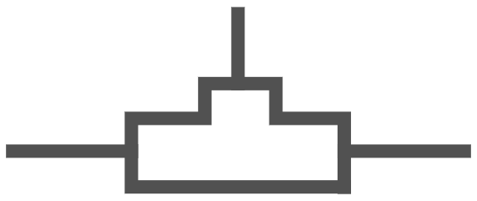
Built-in Controls | Network security
Strengthen network access controls
Configure network access rules, segmentation
Set-up appropriate Network security group (NSG) or Application security group rules & Azure Firewall
Use Virtual Network Appliance to enable additional filtering
Network security groups
VPN
Avoid exposure to the Internet with dedicated WAN links
Use Site to site VPN
Azure ExpressRoute
1
Enable additional protections to ensure application availability
Use Application Gateway & Web Application Firewall
Configure DDoS Protection Standard
Firewalls
Web Application Firewall, Azure Firewall
DDoS Protection

Slide 19

Simplify security with Azure services
Built-in Controls
Identity & access management
Data protection
Network security
Threat protection
Security management
Azure Active Directory
Encryption
(Disks, Storage, SQL)
VNET, VPN, NSG
Azure Security Center
Multi-Factor
Authentication
Azure Key Vault
Application Gateway
(WAF), Azure Firewall
Microsoft Antimalware
for Azure
Azure Log Analytics
Role Based Access
Control
Confidential
Computing
DDoS Protection
Standard
Azure Active Directory
(Identity Protection)
ExpressRoute
+ Partner Solutions

Slide 20
Microsoft privacy statement
Explains what personal data Microsoft processes, how Microsoft processes it, and for what purposes.
Applies to the interactions Microsoft has with users and Microsoft products such as Microsoft services, websites, apps, software, servers, and devices.
Is intended to provide openness and honesty about how Microsoft deals with personal data in its products and services.
For more information, review the privacy statement at Microsoft Privacy Statement.

Slide 21
Trust Center
Trust Center is a website resource containing information and details about how Microsoft implements and supports security, privacy, compliance, and transparency in all our cloud products and services.
The Trust Center site provides:
In-depth information about security, privacy, compliance offerings, policies, features, and practices across Microsoft cloud products.
Recommended resources in the form of a curated list of the most applicable and widely-used resources for each topic.
Information specific to key organizational roles, including business managers, tenant admins or data security teams, risk assessment and privacy officers, and legal compliance teams.

Slide 22
Service Trust Portal
The Service Trust Portal (STP) is the Microsoft public site for publishing audit reports and other compliance-related information related to Microsoft’s cloud services.
It also hosts the Compliance Manager service.
STP is a companion feature to the Trust Center, and allows you to:
Access audit reports across Microsoft cloud services on a single page.
Access compliance guides to help you understand how can you use Microsoft cloud service features to manage compliance with various regulations.
Access trust documents to help you understand how Microsoft cloud services help protect your data.

Slide 23
Compliance Manager
Compliance Manager is a workflow-based risk assessment in the Trust Portal that enables you to track, assign, and verify your organization's regulatory compliance activities
It provide details related to Microsoft professional services and Microsoft cloud services such as Microsoft Office 365, Microsoft Dynamics 365, and Azure.
Compliance Manager provides the following features:
Enables you to assign, track, and record compliance and assessment-related activities.
Provides a compliance score to help you track your progress and prioritize auditing.
Provides a secure repository in which to upload and manage evidence and other artifacts related to compliance activities.

Slide 24
Review Question 1
Q: True or False? When implementing IaaS solutions, network security controls are typically addressed entirely by the cloud solution provider?

Slide 25
Review Question 1
Q: True or False? When implementing IaaS solutions, network security controls are typically addressed entirely by the cloud solution provider?
False – If you’re implementing an IaaS solution you have partial responsibility to make sure that you’re implementing sufficient security controls ( NSG, Firewall, etc. ).

Slide 26
Review Question 2
Q: You’re looking to leverage Azure Security Center to provide just-in-time access control for ports, reducing your attack surface by ensuring the network only allows traffic that you require. What tier(s) of Azure Security Center can you use?
Free Tier
Standard Tier
Both Free and Standard support this functionality.

Slide 27
Review Question 2
Q: You’re looking to leverage Azure Security Center to provide just-in-time access control for ports, reducing your attack surface by ensuring the network only allows traffic that you require. What tier(s) of Azure Security Center can you use?
Free Tier
Standard Tier
Both Free and Standard support this functionality.

Slide 28
Review Question 3
Q: Multifactor authentication requires that you present two or more of the following elements to authenticate:
Something you (1.know, 2.posses, 3.are)
Something you (1.know, 2.see, 3.do)
Something you (1.know, 2.posses, 3.show)

Slide 29
Review Question 3
Q: Multifactor authentication requires that you present two or more of the following elements to authenticate:
Something you (1.know, 2.posses, 3.are)
Something you (1.know, 2.see, 3.do)
Something you (1.know, 2.posses, 3.show)

Slide 30
Review Question 4
Q: Which of the below scenarios can Azure Key Vault be used for?:
Securely store access to tokens, passwords, certificates and other secrets
Securely store encryption keys
Provision and store SSL / TLS certificates

Slide 31
Review Question 4
Q: Which of the below scenarios can Azure Key Vault be used for?:
Securely store access to tokens, passwords, certificates and other secrets
Securely store encryption keys
Provision and store SSL / TLS certificates

Slide 32
Review Question 5
Q: You’re migrating your companies applications to Azure and you need to understand the difference between authentication and authorization on the platform. Which of the following statements are true?
Authorization only uses passwords
Authentication uses usernames and passwords
Authentication uses certificates
Authorization is used to control access to a resource.

Slide 33
Review Question 5
Q: You’re migrating your companies applications to Azure and you need to understand the difference between authentication and authorization on the platform. Which of the following statements are true?
Authorization only uses passwords – False
Authentication uses usernames and passwords - True
Authentication uses certificates - True
Authorization is used to control access to a resource. - True

Slide 34
Apply and monitor infrastructure standards with Azure Policy

Slide 35
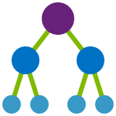




Azure Governance Services
NEW
NEW
NEW
Management Group
Policy
Blueprints
Resource Graph
Cost Management
Define organizational hierarchy
Real-time enforcement, compliance assessment and remediation
Deploy and update cloud environments in a repeatable manner using composable artifacts
Query, explore & analyze cloud resources at scale
Monitor cloud spend and optimize resources
Hierarchy
Control
Environment
Visibility
Consumption

Slide 36
Azure Policy
Active control and governance at scale for your Azure resources
Enforcement & compliance
Apply policies at scale
Remediate & automate
Turn on built-in policies or build custom ones for all resource types
Real-time policy evaluation and enforcement
Periodic & on-demand compliance evaluation
VM In-Guest Policy (NEW)
Apply policies to a Management Group with control across your entire organization
Apply multiple policies and & aggregate policy states with policy initiatives
Exclusion Scope
Remediate existing resources at scale (NEW)
Automatic remediation resources at deployment time
Trigger alerts when a resource is out of compliance

Slide 37
Azure Policy vs Azure RBAC
RBAC
Control actions at different scopes (Mgmt. Group, Subscription, RG, Resource) Example: I want to grant network engineers access to a specific subscription. They only need access to create and manage network resources so I assign them the “Networking Contributor” built-in role.
Policy
Control Resource properties during deployment / modification at different scopes (Mgmt. Group, Subscription, RG) Example: I only want them to be able to provision network resources in the East US 2 region. And all of those resources must be tagged with a standard set of tags.
Initiative: Group of Policies

Slide 38
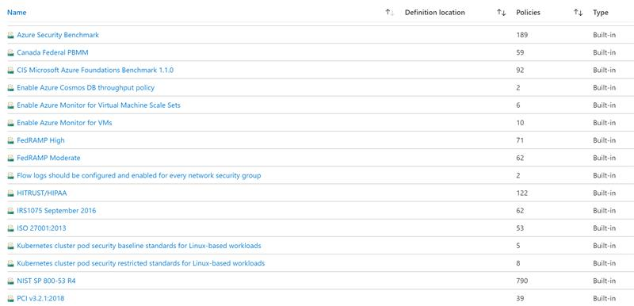
Policy Initiatives (partial)

Slide 39
Demo
Notes:
https://ms.portal.azure.com/#blade/Microsoft_Azure_Security/SecurityMenuBlade/22

Slide 40
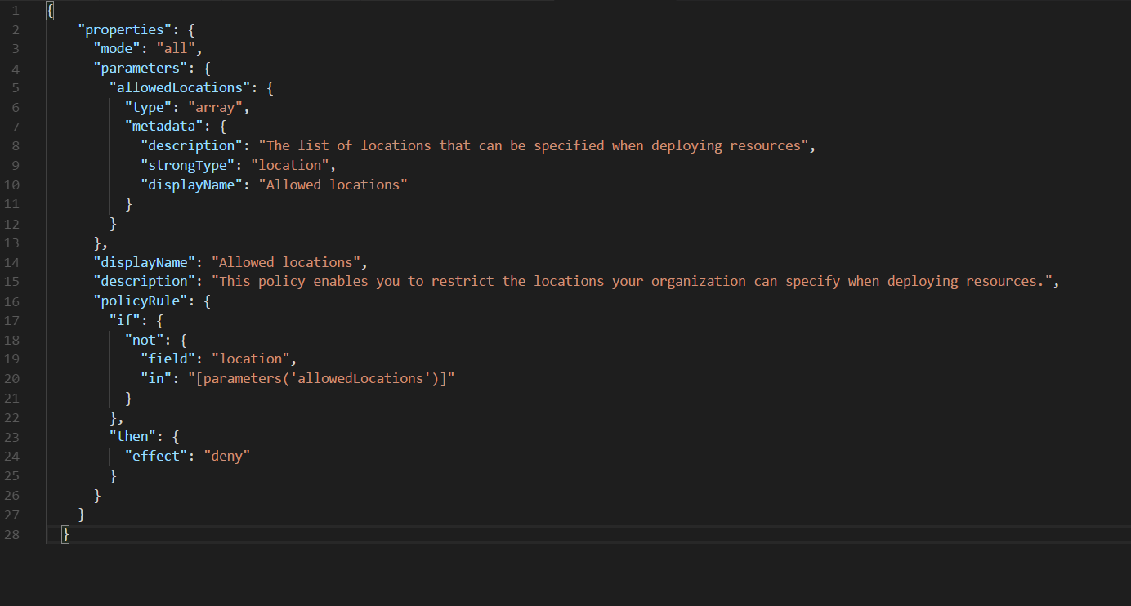
Azure Policy Definition
Restrict resource creation to a specific region / location.

Slide 41
Introducing Azure Management Groups
Efficiently apply governance controls and manage groups of Azure subscriptions
1
`2
3
Fit your organization
Apply controls at scale
Simplify subscription management
Create a flexible hierarchy that can be updated quickly
Mirror the hierarchy to the organizational model that works for you
Scale up or down depending on the organizational needs
Leverage Azure Resource Manager (ARM) objects that integrate with other Azure services
Azure services:
Azure Policy
RBAC
Azure Cost Management
Azure Blueprints
Azure Security Center
Group subscriptions into logical groups
Inherit properties that apply to all subscriptions
View aggregated information above the subscription level

Slide 42

Azure Blueprints
deploy and update cloud environments in a repeatable manner using composable artifacts
Role-based access controls
Policy Definitions
Subscription A
ARM Templates
Azure Blueprints
Subscription B
Subscription C
…
Compose
Manage
Scale

Slide 43


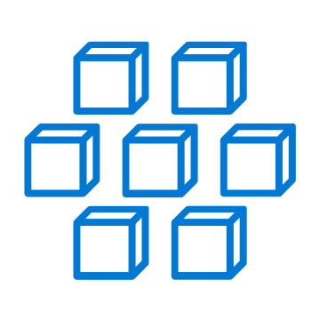

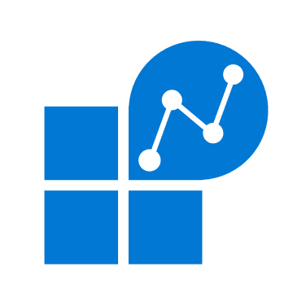













Azure Monitor
Insights
Application
Container
VM
Monitoring Solutions
Application
Operating System
Visualize
Metrics
Dashboards
Views
Power BI
Workbooks
Azure Resources
Azure Subscription
Analyze
Logs
Metrics Explorer
Log Analytics
Azure Tenant
Respond
Custom Sources
Alerts
Autoscale
Integrate
Event Hubs
Logic Apps
Ingest & Export APIs

Slide 44
Review Question 1
Q: You’re trying to implement a control to prevent users from deleting critical networking resources in your subscriptions. What Azure governance technology should you use?
Azure Advisor
Azure Locks
Azure Policy
Azure RBAC

Slide 45
Review Question 1
Q: You’re trying to implement a control to prevent users from deleting critical networking resources in your subscriptions. What Azure governance technology should you use?
Azure Advisor
Azure Locks
Azure Policy
Azure RBAC

Slide 46
Review Question 2
Q: You need to define a set of policies that together will ensure compliance for a variety of resources in a resource group. What Azure governance technology should you use?
Azure Advisor
Azure Locks
Azure Policy
Azure Initiative

Slide 47
Review Question 2
Q: You need to define a set of policies that together will ensure compliance for a variety of resources in a resource group. What Azure governance technology should you use?
Azure Advisor
Azure Locks
Azure Policy
Azure Initiative

Slide 48
Review Question 3
Q: Your rolling out a new solution on Azure and you want to be able to granularly limit access to specific sets of users at the resource level. What should you use?
Azure Advisor
Azure RBAC
Azure Locks
Azure Policy

Slide 49
Review Question 3
Q: Your rolling out a new solution on Azure and you want to be able to granularly limit access to specific sets of users at the resource level. What should you use?
Azure Advisor
Azure RBAC
Azure Locks
Azure Policy

Slide 50
Control and organize Azure resources with Azure Resource Manager

Slide 51
Resource Groups
Container for multiple resources
Resources exist in one* resource group
Resource groups can span regions
Resource groups can span services
RESOU
R
CE G
R
OUP
*and only one

Slide 52
Resource Tags
Resource Tags
Name-value pairs assigned to resources or resource groups
Plan your taxonomy first!
Each resource can have up to 15 tags

Slide 53
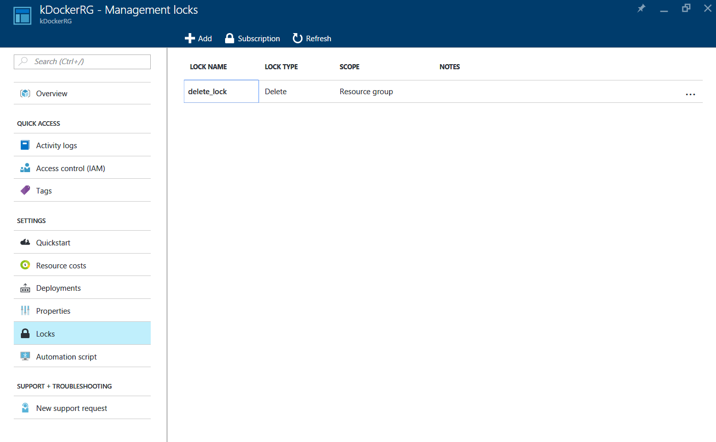
Resource Locks
Prevent Accidental Deletion of Resources.
Lock subscriptions, resource groups or resources.
Lock Levels:
CanNotDelete Authorized users can still read and modify a resource, but they can't delete the resource.
ReadOnly Authorized users can read a resource, but they can't delete or update the resource.

Slide 54
Review Question 1
Q: True or False? – If you delete a resource group, all resources within the resource group will be deleted?

Slide 55
Review Question 1
Q: True or False? – If you delete a resource group, all resources within the resource group will be deleted? True – All resources within a resource group will be deleted if the group is removed.

Slide 56
Review Question 2
Q: You’ve created a resource group and are ready to deploy some resources. What combinations of resources would be supported if the resource group is in the East US 2 region?
3 VMs in “East US”, 2 storage accounts in “West US”
3 VMs in “East US 2”, 2 storage accounts in “East US 2”
3 VMs in “West US”, 2 storage accounts in “West US”

Slide 57
Review Question 2
Q: You’ve created a resource group and are ready to deploy some resources. What combinations of resources would be supported if the resource group is in the East US 2 region?
3 VMs in “East US”, 2 storage accounts in “West US”
3 VMs in “East US 2”, 2 storage accounts in “East US 2”
3 VMs in “West US”, 2 storage accounts in “West US”

Slide 58
Review Question 3
Q: Resource groups can be used to achieve which of the following goals:
Organize resources for billing
Organize resources for life-cycle
Organize resources for authorization
Organize resources by region or geo

Slide 59
Review Question 3
Q: Resource groups can be used to achieve which of the following goals:
Organize resources for billing
Organize resources for life-cycle
Organize resources for authorization
Organize resources by region or geo

Slide 60
Open Q&A

